Slide 1
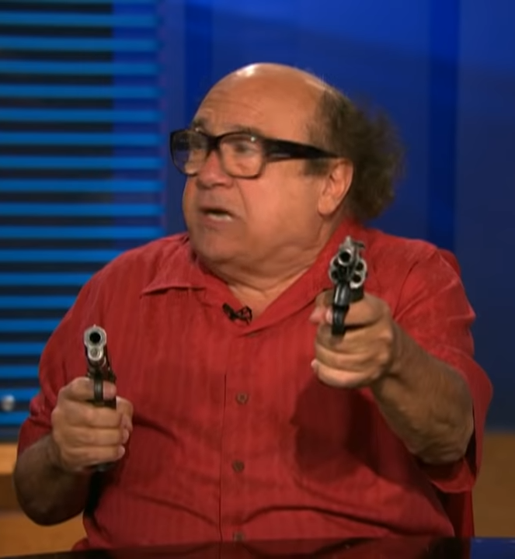

Frank Reynolds
Name
Birth
July 31, 1943
Employment
Paddy's Pub Owner
Personality keywords
Impulsive
Argumentative
Rich (I Think)
Loud
Stupid
Drunk
Hormonal
Short
Bio
Franklin "Frank" Reynolds is the father of Dennis Reynolds and Dee Reynolds, and the ex-husband of Barbara Reynolds. Frank also lives with his apparent biological son (and ex-husband), Charlie Kelly. He is a member of "The Gang" that owns and runs Paddy's Pub. He used to be prim and proper, but after he divorced Barbara, he let himself lose all convictions and live with no moral compass or decency.
Goals
Professional business site
Phone number for ladies to contact him
Personal motivations
Sex
Drugs
Money
Social motivations
To “Bang Everyone”
Financial motivations
More Money
Keep the gang afloat
Image
We must:
Have A Phone Number For ladies To Contact him
A Photo of all his money
An address
His fav guns
Who his friends are
Films hes worked on (Lethal Weapons
A List Of His Companies
We must not:
Mention is taboo habits
Mention his ex wife
Mention his stupidity
Use hard words
Mention he had covid / is antivax
Cannot mention his recent history
Phone
Tablet
Laptop
Desktop
Social net

